Slide 1

Marketing Data and Technology
Draw Insights from Marketing Data

Slide 2

Part One:
Setting Goals

Slide 3
Identify Key Business Objectives
Key Business Objective: A defined goal or outcome used to plan the desired direction of your company. Write at least 3 but no more than 5 business objectives that support your business model. Each objective should be SMART.
1 | SMART Key Business Objective 1 (required) Increase engagement rate by 20% in three months
2 | SMART Key Business Objective 2 (required) Increase number of followers by 30% in two months
3 | SMART Key Business Objective 3 (required) Increase conversion rate by 10% in one month
4 | SMART Key Business Objective 4 (optional)
5 | SMART Key Business Objective 5 (optional)

Slide 4
Identify Key Performance Indicators
Key Performance Indicator (KPI): A quantifiable metric used to determine how effectively your key business objectives are being met. Ensure that the specific metric is clearly identified.
1 | Key Performance Indicator 1 for Key Business Objective 1 (required) Measure the engagement rate
2 | Key Performance Indicator 2 for Key Business Objective 2 (required) The number of followers
3 | Key Performance Indicator 3 for Key Business Objective 3 (required) Number of new customers
4 | Key Performance Indicator 4 for Key Business Objective 4 (optional)
5 | Key Performance Indicator 5 for Key Business Objective 5 (optional)

Slide 5
Part Two:
A/B Testing Proposal

Slide 6
A/B Testing Proposal: KPI, Variable, and Hypothesis
KPI used as basis for the A/B test
The number of followers
Variable that will have an impact on the KPI
The color of the “follow" button on the website.
Hypothesis for your A/B Test
I'll use a red button and another blue one. I think the red button will bring more followers because of its clarity.

Slide 7
A/B Testing Proposal: Details and results
Details of the A/B test
Variations being tested: | “follow" button with red color
 | “follow" button with bleu color
User groups: | I will use tow different URLs for the two button
Data collection tool: | Google Analytics
Length of the test: | One month
Describe how you would determine the results of the A/B test
I will count the number of new followers coming from each of the two links and decide which color to choose based on which button brought in more followers.

Slide 8
Part Three:
Data Exploration

Slide 9
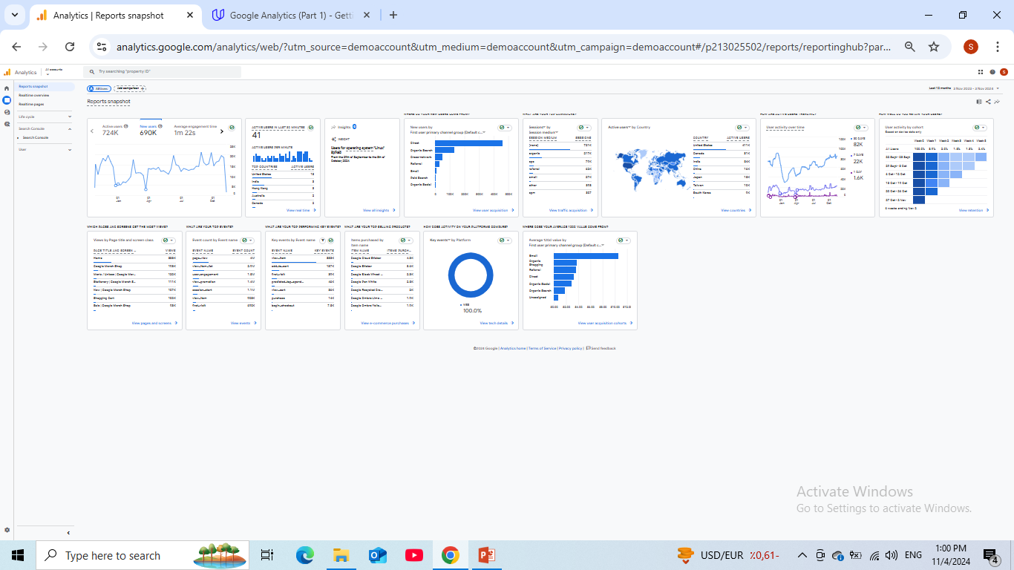
Reports Snapshot
From the Reports Snapshot, select a twelve month time period you would like to explore.
Ensure that the following are visible in the screenshot:
Timeframe
New users
Axis values
Replace this box with screenshot from report

Slide 10
Reports Snapshot
Which month had the most new users?
25-31 August.
Which month had the fewest new users?
24-30 March.
Write some ideas why certain trends are associated with these specific months?
In August, there are holidays and sales that encourage more new users to enter and purchase.

Slide 11
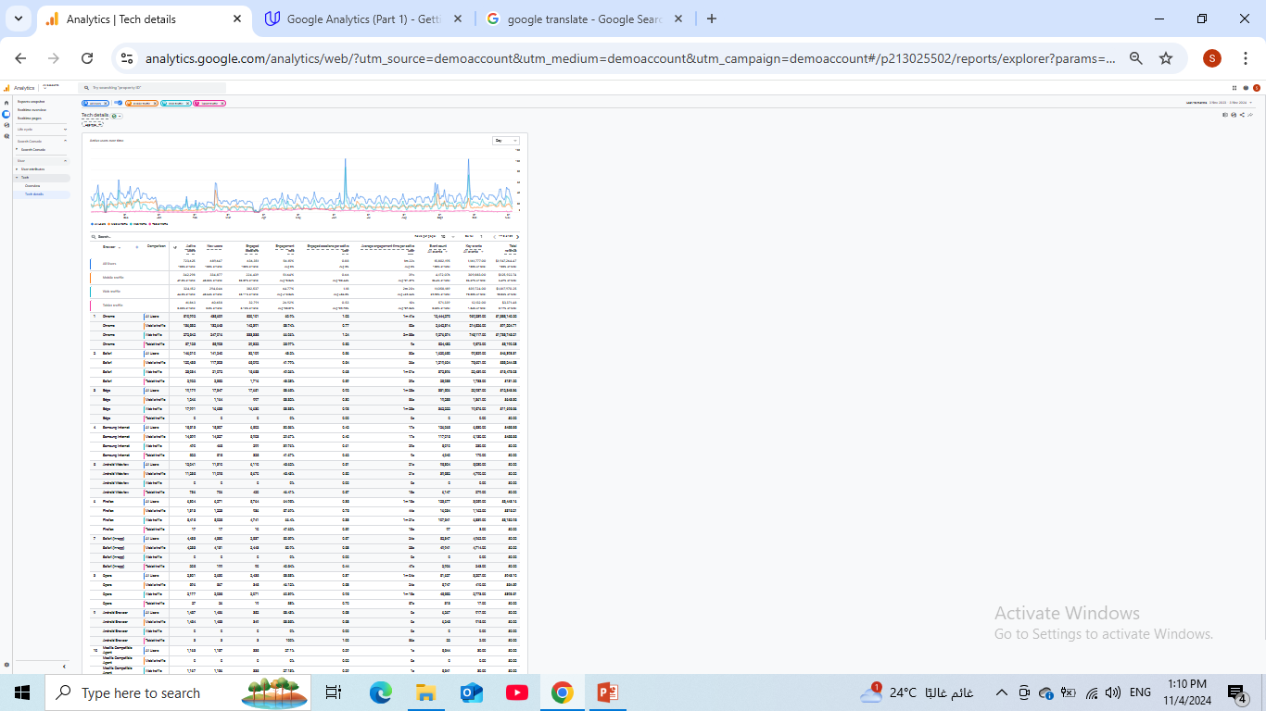
User Tech
Please go into the User → Tech → Tech overview report for the following:
For the twelve month period you’ve chosen, provide a screenshot showing percentage chart (donut charts) of All Users that came from mobile, desktop, and tablet devices.
Ensure that the following are visible in the screenshot:
Device Category
Donut chart showing % breakdown by device
Note that the time frame selected does not need to be visible in the screenshot..

Slide 12
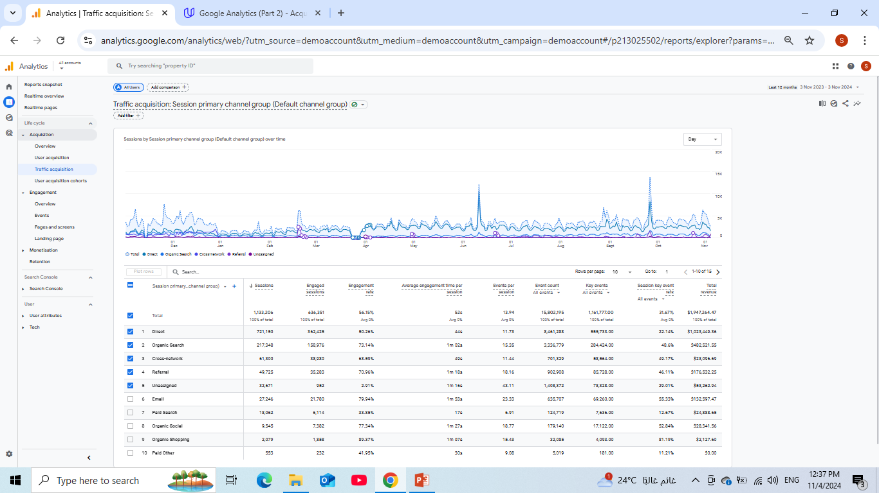
User Acquisition
For this section, if you are using your own business’s Google Analytics data but do not have eCommerce capabilities established, please use the Google Analytics demo data provided from the Google Merchandise store.
Take a screenshot that shows the Engagement rate of the different acquisition channels over a 12 month period.
Ensure that the following are visible in the screenshot:
Channel group
Users
Engagement Rate
Note that the time frame selected does not need to be visible in the screenshot, but will be reflected by the number of users.
Replace thi box with screenshot from report

Slide 13
User Acquisition
Which channel groups had the highest and lowest engagement rates?
The highest engagement rate is Organic Shopping.
The lowest engagement rate is Unassigned.
Which channel groups had the highest and lowest total revenue?
The highest total revenue is Direct.
The lowest total revenue is Paid Other.
What do these metrics mean, based on your experience?
We would not spend more on other channel groups, because they don’t give us any revenue.

Slide 14
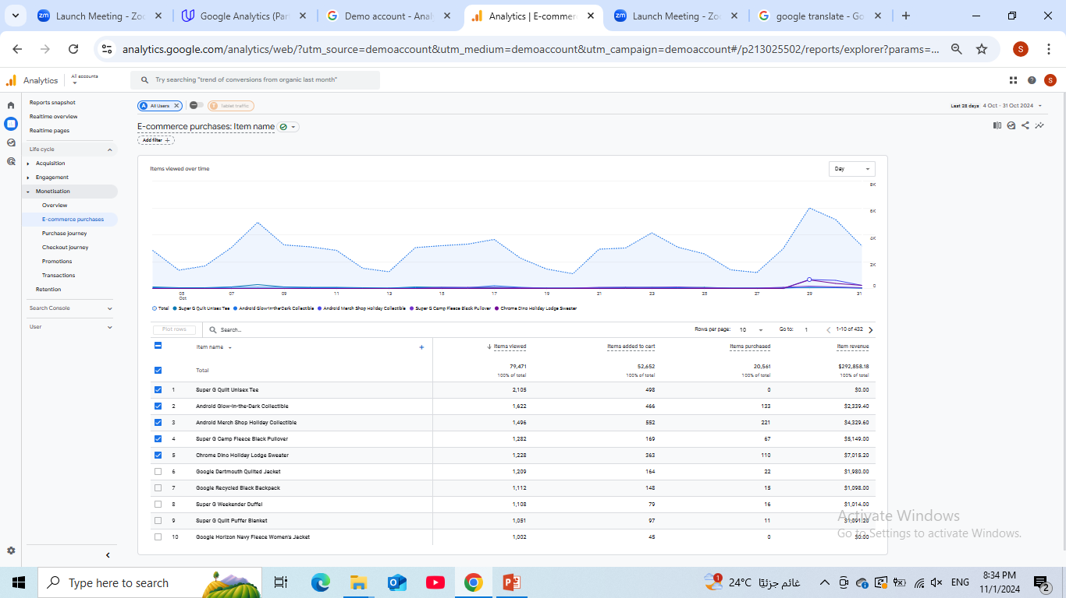
Monetization
For this section, if you are using your own business’s Google Analytics data but do not have eCommerce capabilities established, please use the Google Analytics demo data provided from the Google Merchandise store.
During the twelve month period you’ve selected, provide a screenshot that shows the Item name that contributed the highest number of unique purchases and the item name that was responsible for the largest percentage of revenue? (Screenshot(s) only; no annotation required.)
Ensure that the following are visible in the screenshot:
Item names
Number of items purchased
Item revenue

Slide 15
Part Four:
Segmentation

Slide 16
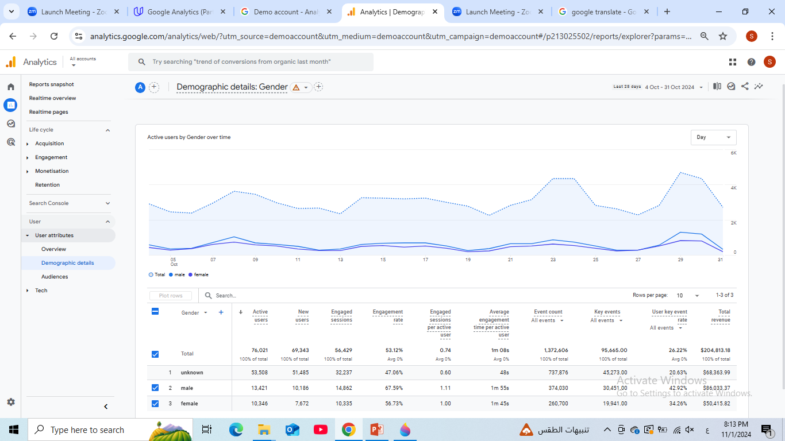
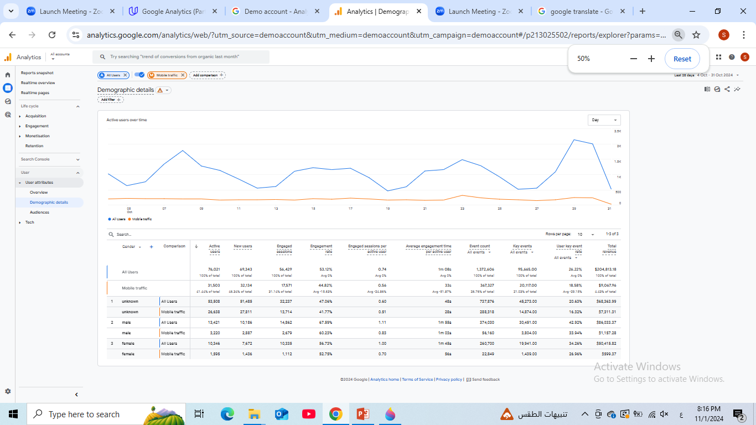
Audience Segment: Demographics
Place the screenshot here, that includes a comparison of your chosen Audience Demographic segment and “All Users”
Values used: | Mobile traffic Device category exactly matches “mobile”

Slide 17
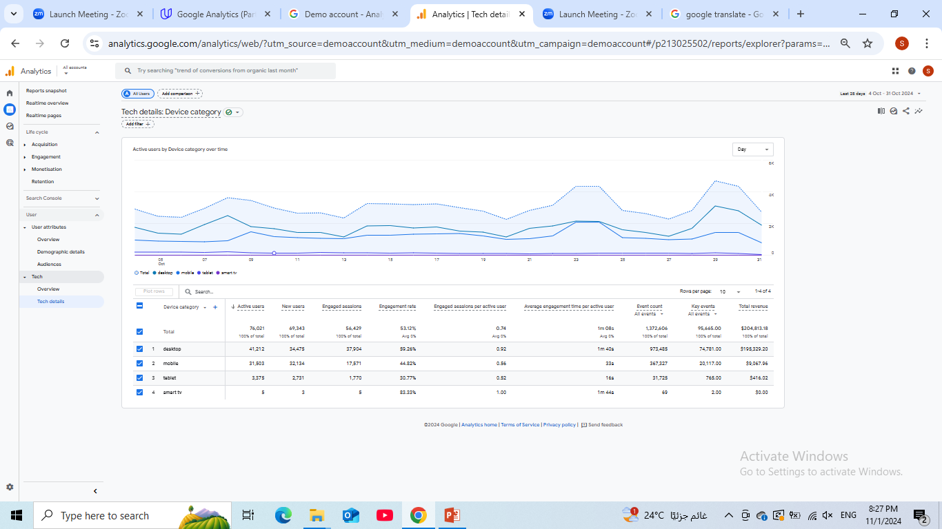
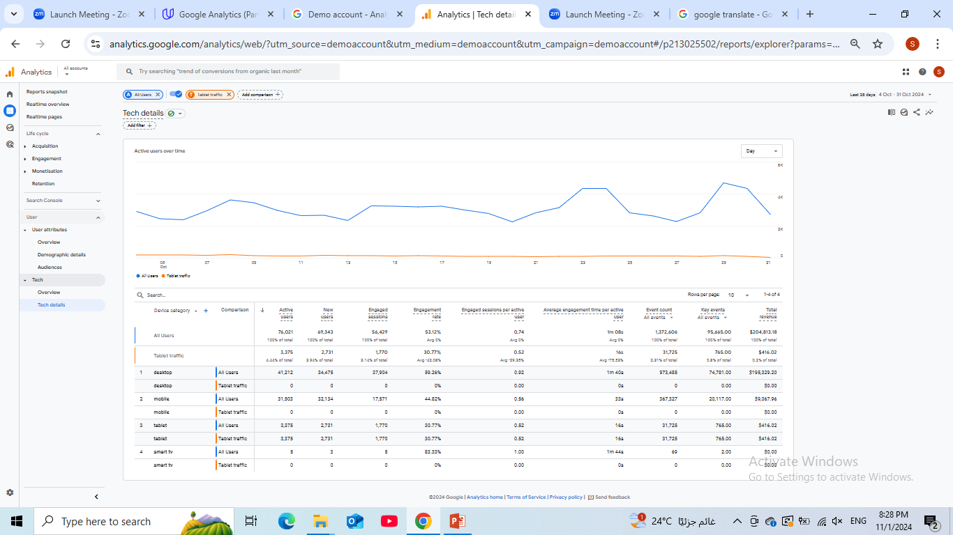
Audience Segment: Technology
Place the screenshot here, that includes a comparison of your chosen Audience Demographic segment and “All Users”
Values used: | Tablet traffic Device category exactly matches “tablet”

Slide 18
Part Five:
Analysis and Suggestions

Slide 19
Google Merchandise Store data
You can find the results of the Google Merchandise Store campaigns below.
Campaign Name | Cost | Revenue | ROAS
Tech Trends: Discover the Latest Google Gear | $5,000 | $3,000 | 0.6
Shop with Google: Unleash Your Digital Lifestyle | $5,000 | $8,000 | 1.6
Google Gadgets Galore: Elevate Your Tech Game | $5,000 | $8,000 | 1.6
Gear Up with Google: Your One-Stop Tech Shop | $8,000 | $13,000 | 1.625
Google Merch Madness: Score Big on Tech Essentials | $5,000 | $2,000 | 0.4
Unlock the Power of Google: Shop the Best in Tech | $2,000 | $3,500 | 1.75
Totals | $30,000 | $37,500 | 1.25

Slide 20
Business Sales Growth
Based on the data provided, how might the campaigns be realigned and improved to potentially achieve a 20% YOY sales growth without additional cost? You can assume that the data will remain consistent over the projected time frame. Please reference specific data to support your answer, such as metrics and campaigns.
You could get the answer by asking yourself: Which campaign would I spend less, and which would I spend more?
I will reduce the cost of campaign number 1 by 3000$
Also reduce number 5 by 2500$
Because the ROAS of them are less than others.
I would spend more on the campaign which its ROAS the biggest.,
I would spend more on Campaign number 4 by 2500$
(I have detailed this in the following column)
Notes:
is

Slide 21
Business Sales Growth
Campaign Number | Campaign Name | Revised Cost | Estimated Revenue | ROAS
1 | Tech Trends: Discover the Latest Google Gear | $2,000 | $1,200 | 0.6
2 | Shop with Google: Unleash Your Digital Lifestyle | $8,000 | $12,800 | 1.6
3 | Google Gadgets Galore: Elevate Your Tech Game | $5,000 | $8,000 | 1.6
4 | Gear Up with Google: Your One-Stop Tech Shop | $10,500 | $17,062.5 | 1.625
5 | Google Merch Madness: Score Big on Tech Essentials | $2,500 | $1000 | 0.4
6 | Unlock the Power of Google: Shop the Best in Tech | $2,000 | $3,500 | 1.75
 | Totals | $30,000 | $43,562.5 | 1.452

Slide 22
eCommerce improvements
Looking at your website pages or the Google Merchandise Store website and current eCommerce experience, identify one change to the eCommerce UX and one additional eCommerce option you would recommend implementing.
Example: One way to improve eCommerce capabilities would be to add the option of a digital wallet with the option to securely store and manage cards that have been used for payment, along with the option of using PayPal or Apple Pay.
UX change:
Pictures must show product dimensions.
Other eCommerce change or addition:
Payment methods should be diverse and easy to use.

Slide 23
Technology
It is time for some exploration! You need to find 2 emerging marketing technologies that you could use in a technology stack. For each one, you need to describe why you would use that tool.
1 | HubSpot
 | To easily manage all my communication channels together in one place.
2 | Chat bots
 | To keep in touch quickly with customers.

